Slide 1
FORMAL LETTER WRITING

Slide 2
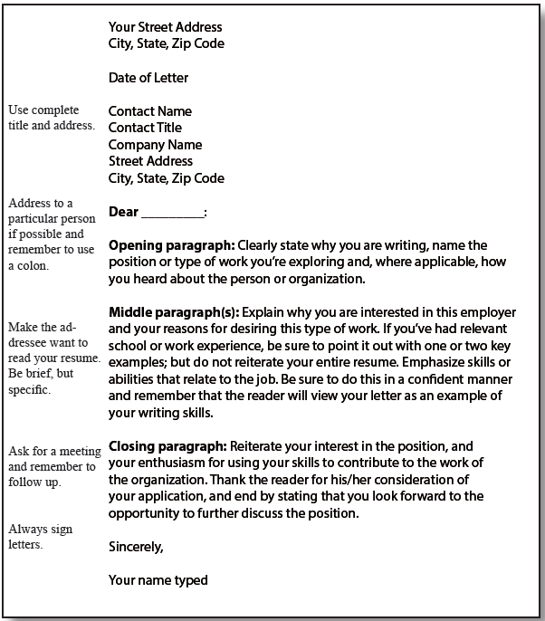
Some general rules about letters:

Slide 3
Address your letters to a specific person if you can.
Tailor your letters to specific situations or organizations by doing research before writing your letters.
Keep letters concise and factual, no more than a single page.
Avoid flowery language.
Give examples that support your skills and qualifications.
Put yourself in the reader’s shoes. What can you write that will
Convince the reader that you are ready and able to do the job
Don’t overuse the pronoun “I”.

Slide 4
Have an adviser proofread your letter.
If converting to a .pdf, check that your formatting translated
correctly.
Reference skills or experiences from the job description and
draw connections to your credentials.
Make sure your resume and cover letter are prepared with the
same font type and size.

Slide 5
Write a new cover letter for each application.
Research the company.
Don’t repeat your resume.
Think about what the company needs.
Highlight relevant experiences.
Emphasize your strengths.
Keep it short and focused.
Edit and proofread.

Slide 6
Catherine Johnson Number, Street Name New York City, NY 72823 123)-456-7890 Email Address
November 23, 2020
Samuel Smith Hiring Manager Company name Number, Street Name New York City, NY 32172
Dear Mr. Smith,
I was excited to find your job listing for the Machine Learning Engineer (MLE) position on [URL address] under section [‘Work at’]. As an experienced MLE, I have a proven track record of designing and developing machine learning and deep learning systems. Therefore, I would like you to consider this job application for the MLE position at your establishment in New York City.
To shortly introduce myself, my name is ABC and I have been creating artificial intelligence systems for the past five years at [Organization]. Currently, I seek to obtain a new, challenging and growth oriented position in my field of interest. I noticed [Company name]’s involvement in artificial intelligence and human moderation to combat spam and abuse. The developments mentioned in [Article] surely are a leap forward to secure media platforms.
Over the past five years as MLE at XYZ Organization, I have been implementing machine learning into e-commerce processes to improve customer engagement and loyalty. E-commerce platform had approximately five million monthly visitors whilst losing roughly 300k from bad search and my goal was to improve conversion. In 2020, we managed to boast a 13% increase in “add to cart” and an 18% increase in click-through rate. I was praised for these results (see references). I am convinced that my expertise, resistance to stress and ability to work overtime will be an asset to your development team.
I would be pleased to discuss my candidacy and demonstrate scalable machine learning solutions in production. You can find my resume and portfolio in the attachment. If you require any further information, you can reach me on [000-0000-0000] at any time. Thank you for reviewing my cover letter. I look forward to hearing from you.
Best regards,
Catherine Johnson

Slide 7
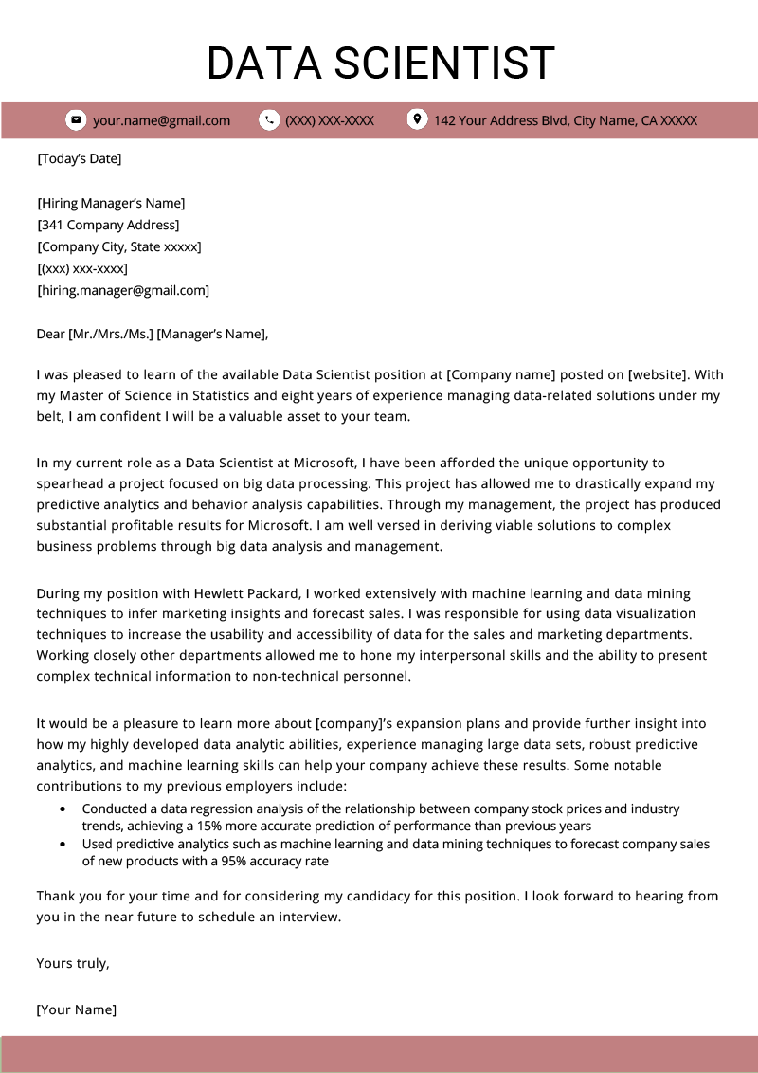
+

Slide 8
